Slide 1
Minimum Cost Flow Program With Successive Shortest Path Algorithm
SYS 3021 Final Project
Sammy Park, Anika Sharma, Manasi Srigiriraju
Notes:
Submit pdf of paper, ampl files, this ppt, and recording

Slide 2
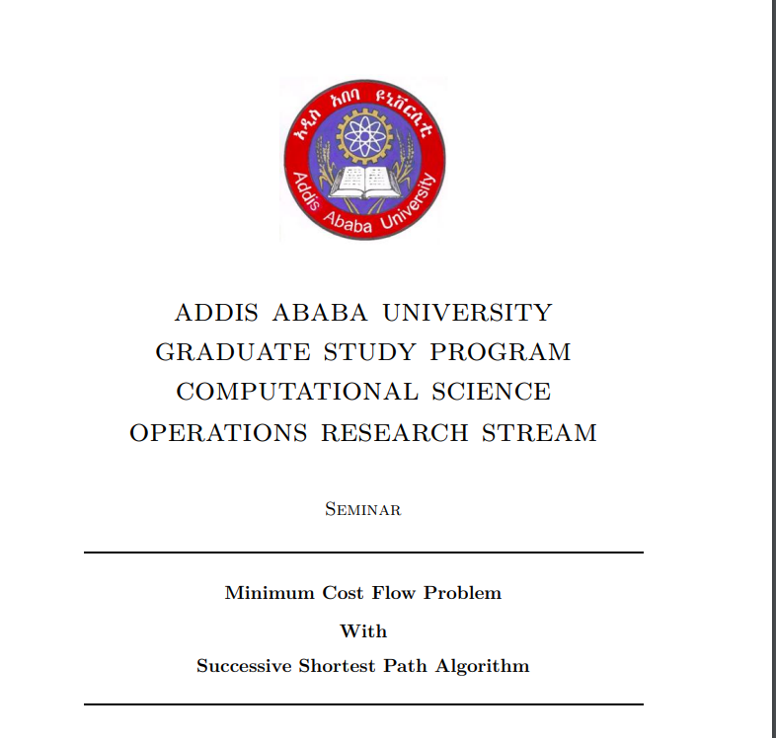
Introduction To the Paper
Selected a paper called Minimum Cost Flow Problem With Successive Shortest Path Algorithm presented in a seminar at the Addis Ababa University Graduate Study Program Computational Science Operations Research Stream.
Authored by Mesfin Diro on August 13, 2012 and supervised by Berhana Guta
The paper goes over minimum cost flow problems and their basic properties, transformations, special cases, optimization conditions, and solution methods.

Slide 3




“Why we chose this paper?”
Scope of Paper: Gives a broad understanding to Minimum Cost Flow Networks while also connecting several specific topics that we discussed throughout the semester such as assignment and transportation problems.
Focus on Minimum Cost Flow Problems: After learning about several different types of network flow problems, our group member garnered a special interest in minimum cost flow since the cost factor is a component used in many real world scenarios.
Real world applications: Minimum cost flow problems in particular can be used to look at a number of important scenarios such as assigning a set given conditions to be met. In particular, we chose to focus on a transportation problem, which involves looking at minimizing transportation cost of a given commodity from a number of sources or origins
Author Credibility: Part of our search for a paper involved looking into the credentials of the author. Through our external research, we determined that the author, Mesfin Diro, as well as the affiliated university, Addis Ababa University, are both reputable and respected in the field with numerous works and publications.

Slide 4
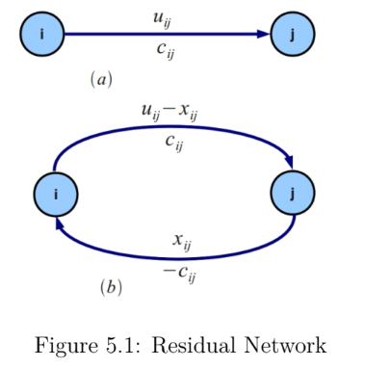
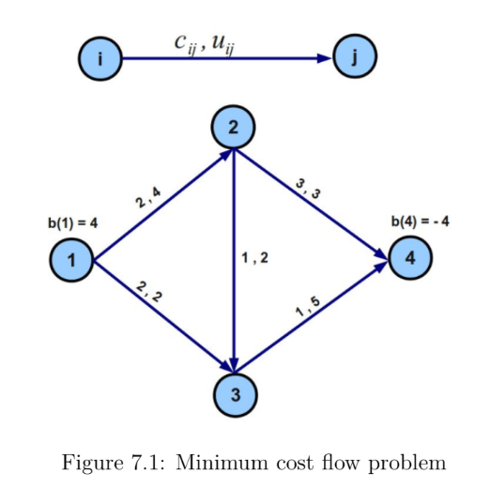
Literature Review
Diro starts by introducing two types of network flow models: generalized and pure, which differ in the difference between the amount of flow entering and leaving an arc
Delves into how a minimum cost flow problem is structured along with real world applications such as within the scope of transportation and logistics
Generalized and pure min cost flow problems are introduced again, this time in the context of mathematical modelling implications
Diro mentions some mechanics of minimum cost flow problems including the complementary slackness condition which provides cases for classifying arc conditions
Basic properties of the pure MCFP Network are introduced with the feasibility conditions and integer solutions property to describe the necessary conditions that must be met
Diro also provides us with information on transformations of MCFP, which include a flow balance transformation, upper and lower bounds transformation, and a Pure MCFP to circulation transformation.
These transformations differ in the bounds, and sources and sinks
There are also special cases that make up the min cost flow problem including shortest path, maximum flow, transportation problems and assignment problems
While Diro does provide some insight into each type of problem, these have different goals and objectives overall
The concept of residual capacity is established as the the amount of available capacity which contains forward and backward arcs along with the required optimality conditions for MCFP
The top right image demonstrates this principle with a visual depiction of the forward and backward arcs.
Diro concludes the paper by focusing back on pure MCFP, this time highlighting solution methods such as the successive shortest path algorithm.
The bottom left image shows a visual representation of this algorithm which maintains a flow that is not necessary feasible

Slide 5
Problem Statement
ASM Custom Prints is a small business that grew to prominence through TikTok and other social media and has recently been picked up by Target and Walmart. Because ASM is still a growing business, the two founders (Sammy and Anika) still produce and customize t-shirts and hoodies in their own homes. Afterwards, Sammy ships directly to Target, and Anika ships directly to Walmart. The customized merchandise is also tagged before selling. Sammy and Anika can both attach tags themselves, or they can send them to Manasi, their majority shareholder, who also tags merchandise before delivering them to either Target or Walmart.
Sammy produces 200 units.
Anika produces 150 units.
Target needs 180 units.
Walmart needs 170 units.
Sammy delivers directly to Target, and Anika delivers directly to Walmart. Sammy and Anika can send up to 90 units each to Manasi, who can also deliver up to 90 units to either retail store.
How many units (articles of custom merchandise) should be sent along each path?

Slide 6
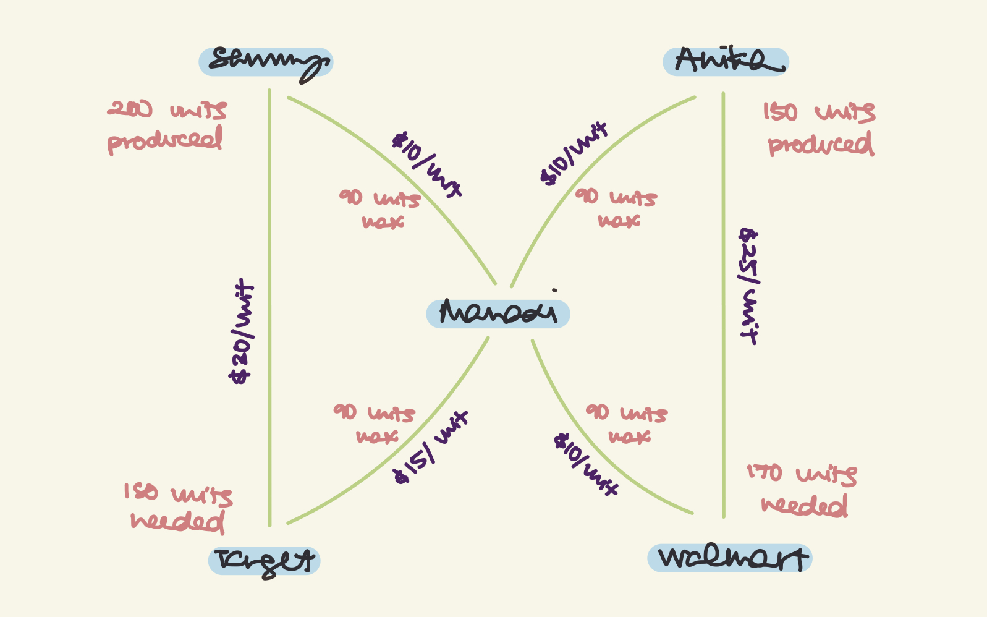

Slide 7
Math Program
Sets:
NODES defines the nodes in our minimum cost flow network to model our created data with two supply nodes (Sammy/Anika warehouses), two demand nodes (Walmart/Target), and one transshipment node (Manasi).
ARCS defines the connections between nodes with two direct arcs from the warehouse to demand nodes and 4 arcs that go through the transshipment node to the demand node
Parameters:
SUPPLY defines the supply of units in each warehouse
DEMAND defines the demand of units in each store
CAPACITY defines the capacity of the 4 arcs that go through the transshipment node
UNIT_COST defines the cost of each unit being transported through an arc/path
Variables:
DELIVERY defines how many units to transport through each arc that is limited by capacity
Objective Function: the objective function is to minimize the cost of transporting the units while meeting the required demand at each demand node.
Constraints:
The units delivered in and out of the transshipment node has a capacity of 90 units
The total supply equals the total demand delivered
There are non-negative values of units delivered to each node
Notes:
Sammy

Slide 8
Assumptions
We created our data and problem statement to reflect what we read on our paper about a pure MCFP network and their properties. Our simplification of a realistic supply and demand system was our assumption in that:
Sammy ships only to Target and Anika only to Walmart
This assumption is fair as it could be cheaper for business to have a warehouse deliver to only one destination
It would be cheaper to have the products be sent and tagged by Manasi
This is assumption is fair because the amount to be tagged could be seen as a service by Manasi to maximize the amount of products going through her.
The capacity of products sent to Manasi is 90
This is assumption is fair because providing a tagging service could only profit up to a certain point before the labor outweighs the return
The costs of delivering to Manasi is cheaper than directly to the store
This assumption is fair because the time taken to tag the products is taken out and put into Manasi’s costs which is not part of the objective function for ASM.
Notes:
Sammy

Slide 9
Results from AMPL
After generating our .mod and .dat files, we ran the solver on AMPL and found our optimal solution.
The minimized cost is $7,400 if:
Sammy delivers 180 units directly to Target
Sammy delivers 20 units to Manasi and Manasi delivers to Walmart
Anika delivers 80 units directly to Walmart
Anika delivers 70 units to Manasi and Manasi delivers to Walmart
Notes:
Sammy

Slide 10
Discussions and Conclusions
In the paper, it was discussed that a pure network is defined as a model with the net flow equaling zero and having no gains or losses. Our transportation minimum cost flow problem with limited arc capacities and associated costs had two supply nodes and two destination/demand nodes. Our model followed the basic properties outlined in the paper and was feasible as the total supply equaled the total demand. The optimality condition we aimed for was to reduce the costs of delivering products as depicted in our created problem and dataset as well as using the successive min cost flow formulation to find our optimal solution. Diro goes further in other ways we could explore pure MCFPs like using another algorithm to solve the problem like the network simplex algorithm that uses spanning-tree bases or transforming the problem to include lower and upper bounds. As for AMPL, it is a great alternative to Excel for linear programming and we were able to explore and interact with the amplide interface throughout this project.

